Slide 1
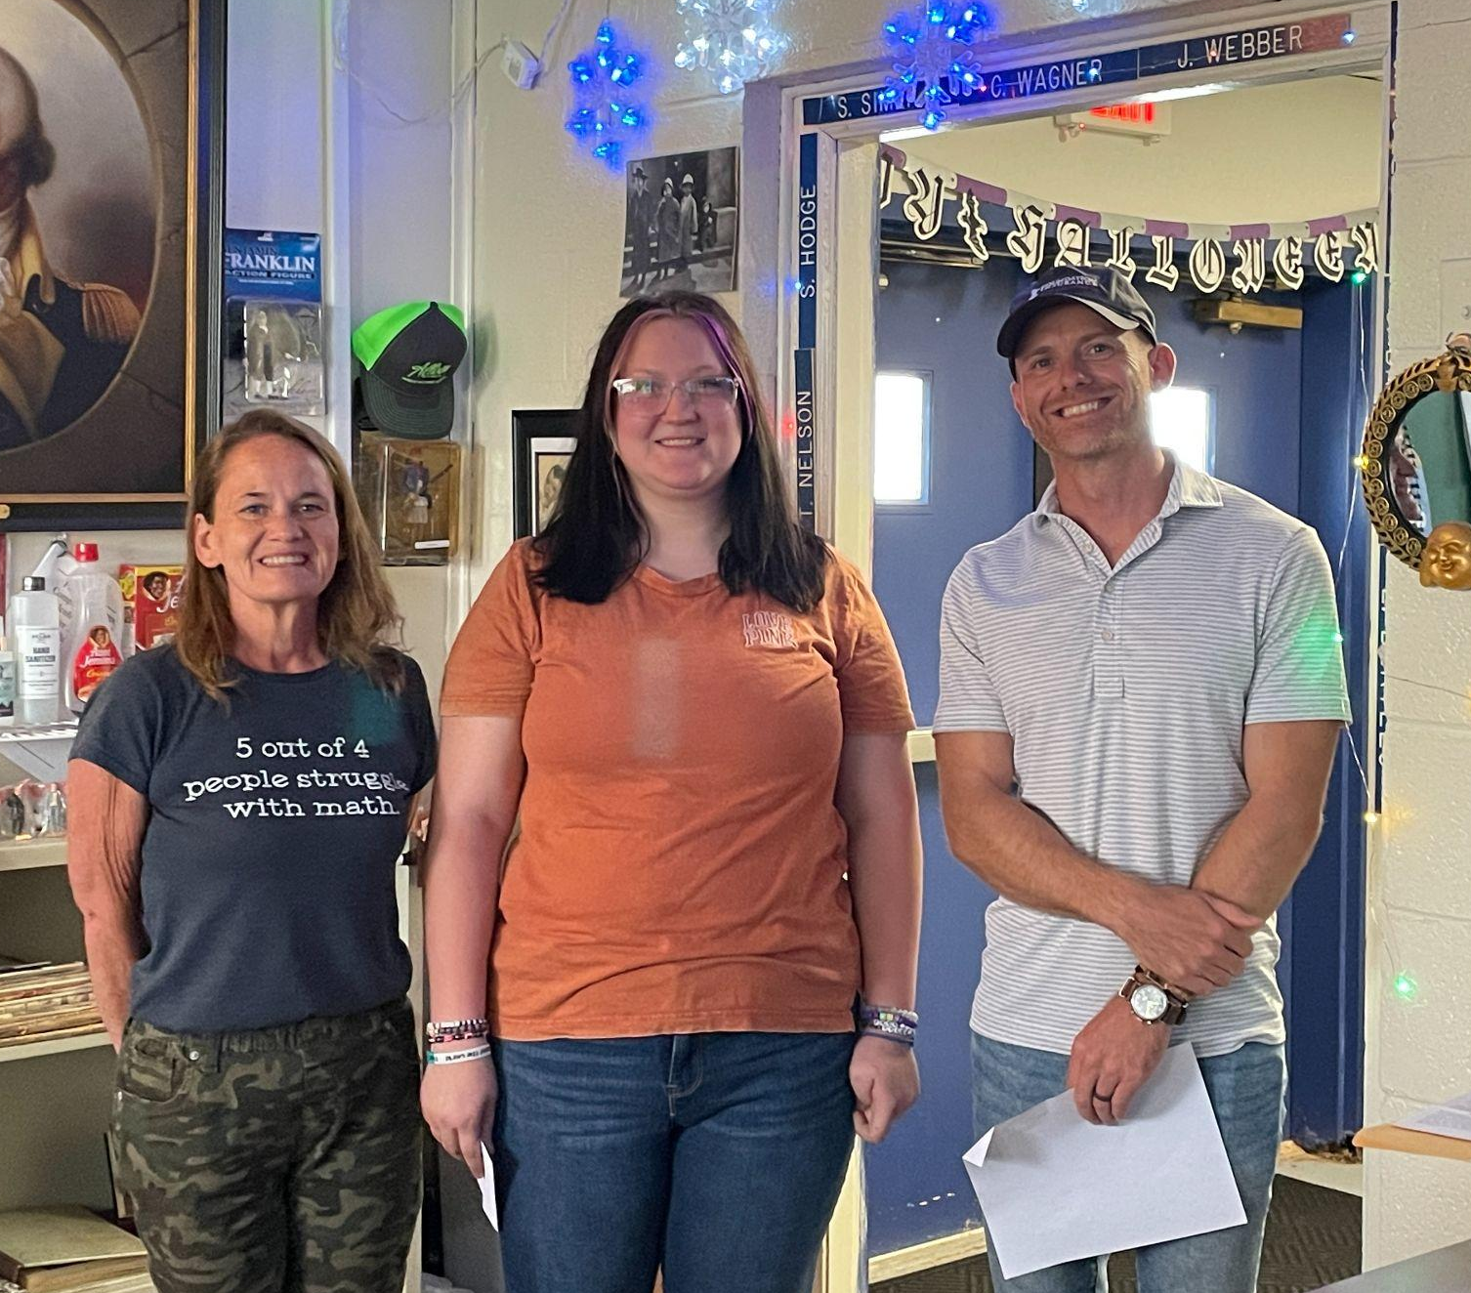
Guthrie Public Schools
STUDENT OF THE MONTH
OCTOBER 2023

Slide 2
HAPPY BIRTHDAY!!
Oct. 07 - Hunter Day
Oct. 14 - Emma Cowan
Oct. 27 - Tyler Robinson

Slide 3
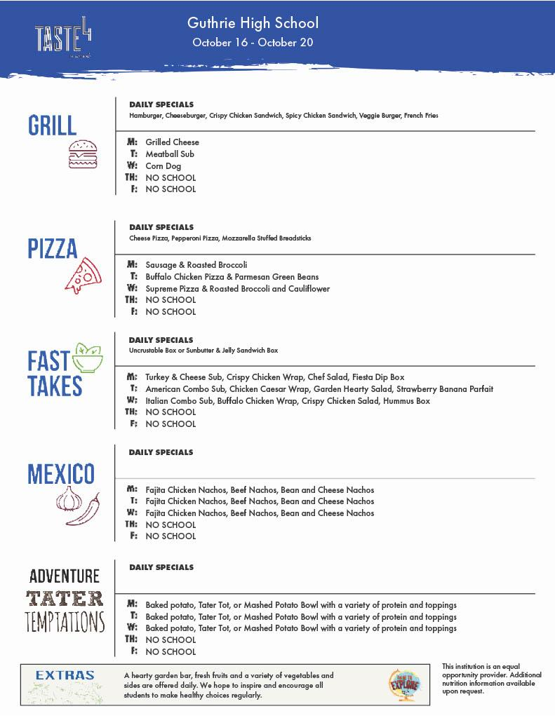

Slide 5
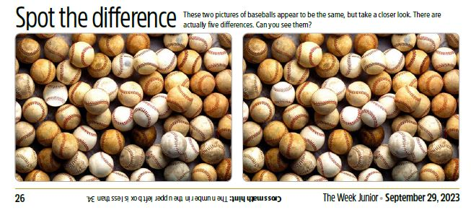

Slide 6
Class Signups
Class of 2024– Google Classroom: ue53f5h Remind: Text @ghs2024-2 to 81010
Class of 2025– text @jrsrock25 to 81010
Class of 2026– Google Classroom code: pv42od5

Slide 7
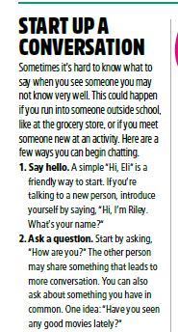
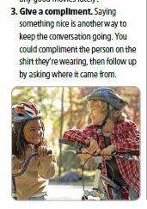
What’s your favorite conversation starter?

Slide 8
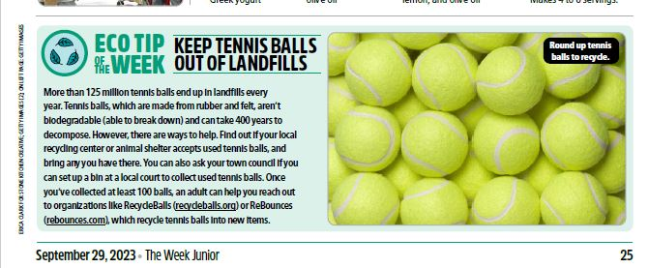

Slide 10
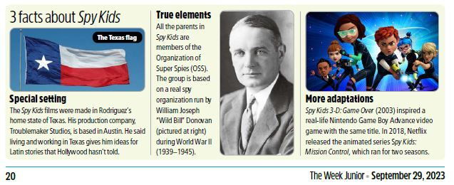

Slide 11
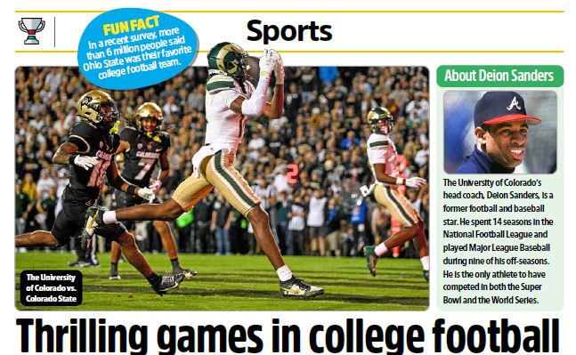

Slide 12
Who has completed the most courses this semester?
???

Slide 13
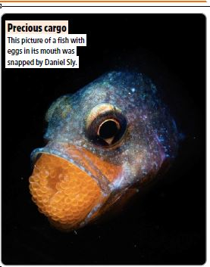

Slide 14
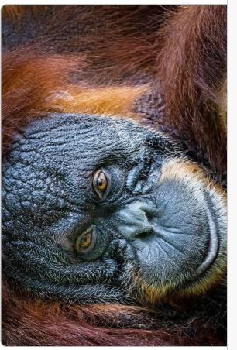

Slide 15
What do I need to graduate???
25 credits in the specified areas**
English: I, II, III, IV
Math: Algebra I, Geometry &
Algebra II, or Math of Finance, or PreCalc
Science: Biology, Physical Science or Chemistry &
an additional Science Course
History: OK History, World History, US History, Government

Slide 16
Graduation Credits, con’t
Fine Arts: 1credit (2 semesters)
Personal Financial Literacy (1 semester)
Electives: approximately 10 credits to equal 25 total credits
ALSO:
CPR Training
iCAP Completion
ACT Exam - at GHS in Spring
State US History Exam
State Science Exam

Slide 18
SCHOOL CALENDAR
Fall Break: Thursday & Friday - October 19 & 20
Thanksgiving Break: All Week - November 20-24
Christmas Break: Over Two Weeks - December 18 - January 2
Second Semester Begins: Wednesday, January 3

Slide 19
Who’s Ahead in the Stock Market Game????
???

Slide 20
Stocks & Bonds
Top Investors - Oct 17

Slide 21
Group 1
$6,370 Josh Massey
$5,990 Hunter Day
$5,960 Nate White
$5,750 Austin Matthews
$5,680 Hayden Hinkle
$5,600 Robert Hart
$5,240 Jason Campos
$5,000 Cody Cargill
$4,320 Tyler Robinson

Slide 22
Group 2
$8,780 Taylor Mathews
$7,380 Thomas Talley
$6,890 Dominique Townsend
$6,850 Peytyn White
$6,030 Will Steadman
$5,930 Kayleigh Fawcett
$5,880 Kayden Clay
$5,020 Jocilinn Fairlamb
$5,000 Nik Cade

Slide 23
Group 3
$7,400 Melissa Hernandez
$7,200 Macey Lee
$6,970 Andrea Smith-Gray
$6,770 Lorin Babcock
$6720 Victoria Davis
$6,220 Mashayla Robles
$6,180 Keegan Wanzer
$6,150 Emmary Cowan
$5,810 Kaleeha Smith
$5,040 Karlie Scott
$5,000 Aurora Stone

Slide 24
SCHOOL PIC MAKEUPS
Thursday, November 2

